Slide 1
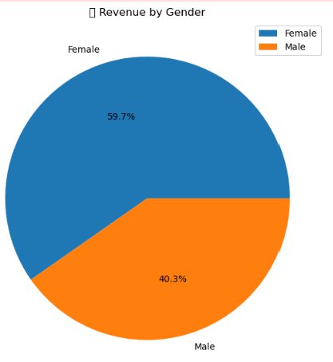
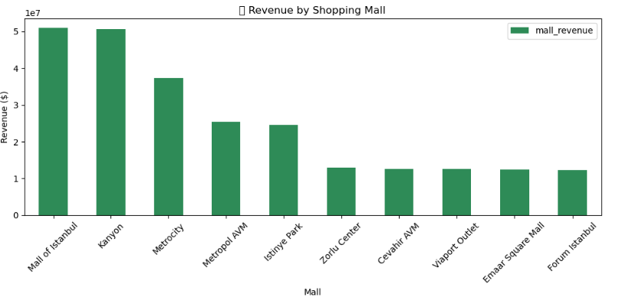
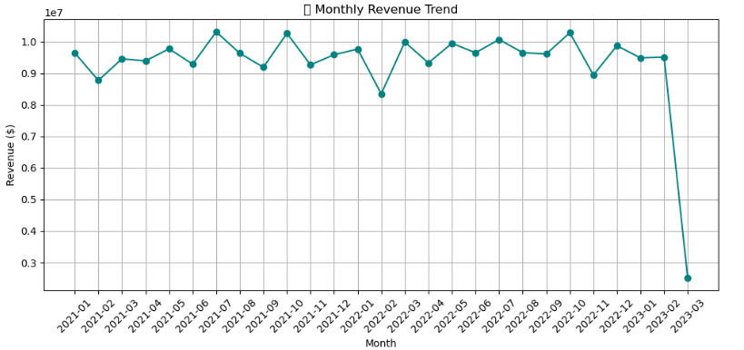
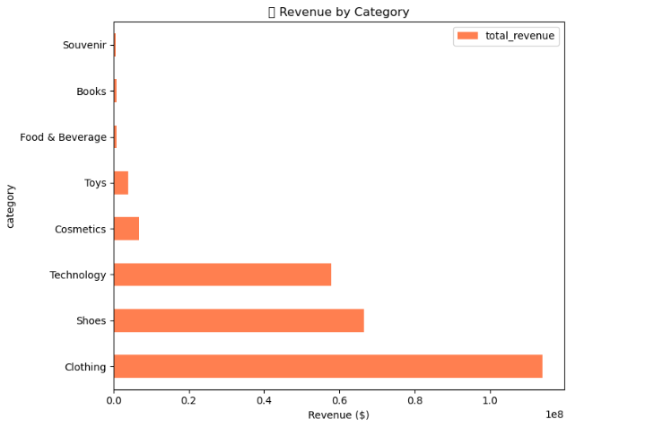
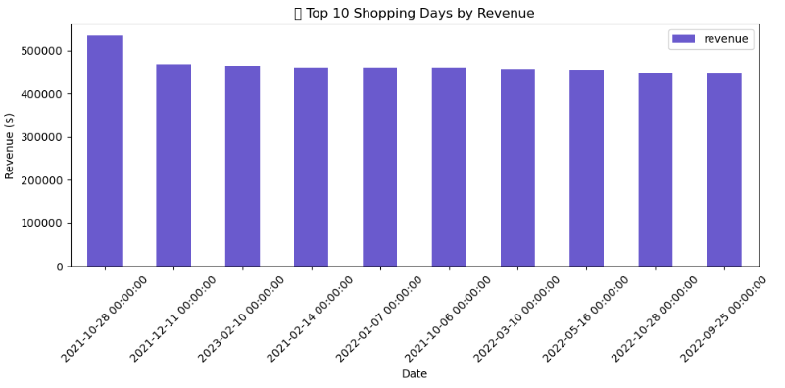
📊 Customer Shopping Insights(SQL + Python Powered Exploratory Analysis)
Dataset: https://www.kaggle.com/datasets/mehmettahiraslan/customer-shopping-dataset
(Customer Shopping Data, 2021)
Overview:
This project analyzes customer shopping behavior using a retail dataset of 99,000+ transactions. The goal is to uncover trends in revenue, purchase patterns, demographics,and payment preferences using SQL for data querying and Python for visualization.
🛠 Tools: SQLite, SQLAlchemy, Pandas, Matplotlib
🎯 Goal: Understand revenue, customer patterns, categories
Gender-wise Revenue
🏬 Revenue by Shopping Mall
📈 Monthly Revenue Trend
📊 Revenue by Product Category
📅 Top 10 Revenue Days
🔍 Key Insight: Revenue peaked during key months, likely influenced by promotional events or seasonal shopping. Gender and mall-based spending patterns reveal balanced customer engagement across demographics and locations..

